Slide 1
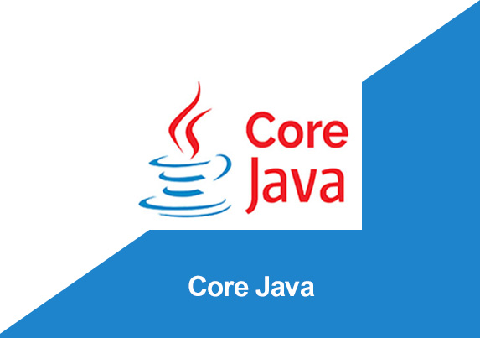
By: Manas Tuwani

Slide 2
VARIABLES IN JAVA
We are using variables to store the values which we can reuse them for multiple times. There are 3 different types of variables available in java.
1. Local variables
2. Static variables
3. Non-static variables/ Instance variables

Slide 3
Local Variables
Local variables are the variables which we are creating inside the method/block and the scope of the local variable is only within the method. That means when we close the method, automatically the usage of the local variable also will be closed.

Slide 4
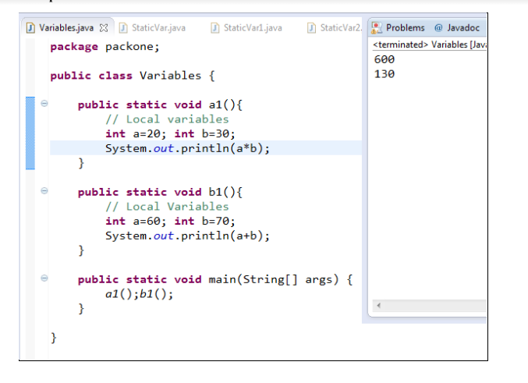

Slide 5
Static Variables
Static variables are the variables which we are creating inside the class and these variables are loading while class is loading.
These static variables we can access directly within the same class, Classname.Variable name in different class, Class name. Variable name in different package but make sure that variable should be public and import statements are required.
Note: We will declare static variable with Static keyword

Slide 6
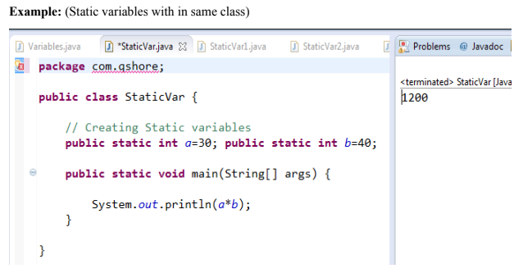

Slide 7
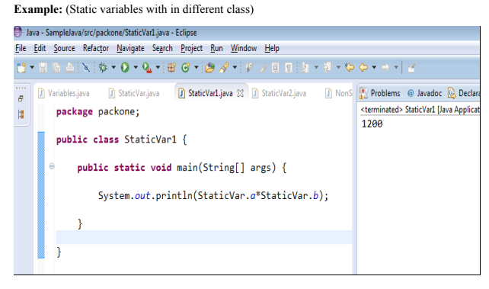

Slide 8
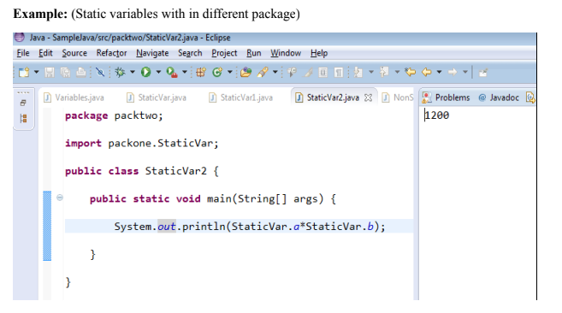

Slide 9
NonStatic Variables
NonStatic variables are creating inside the class and these variables are loading while object creating. We can access non-static variables anywhere with the help of object.
Syntax for creating Object:
Classname objectname = new Classname();
Classname objectname = new Constructor();

Slide 10
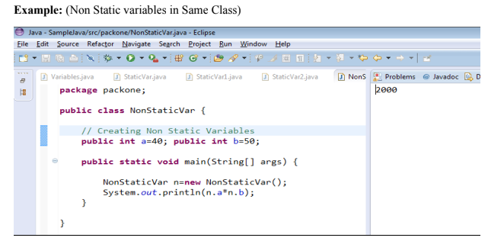

Slide 11
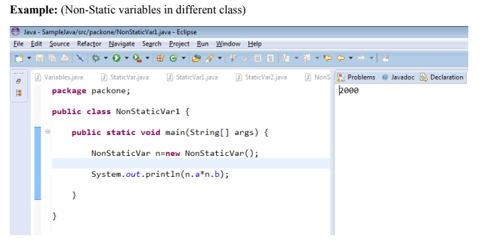

Slide 12
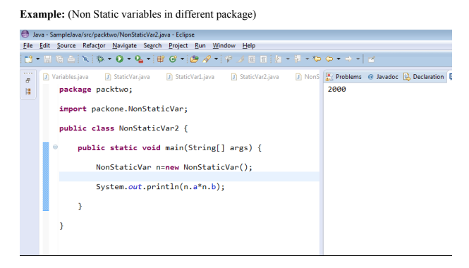

Slide 13
Commenting in Java
We are using commenting not to execute specific lines of the code in a java program and to provide additional information in a java program.
For applying commenting for single line of the code we are using “//”
For applying commenting for group of statements “/* */”

